Slide 1
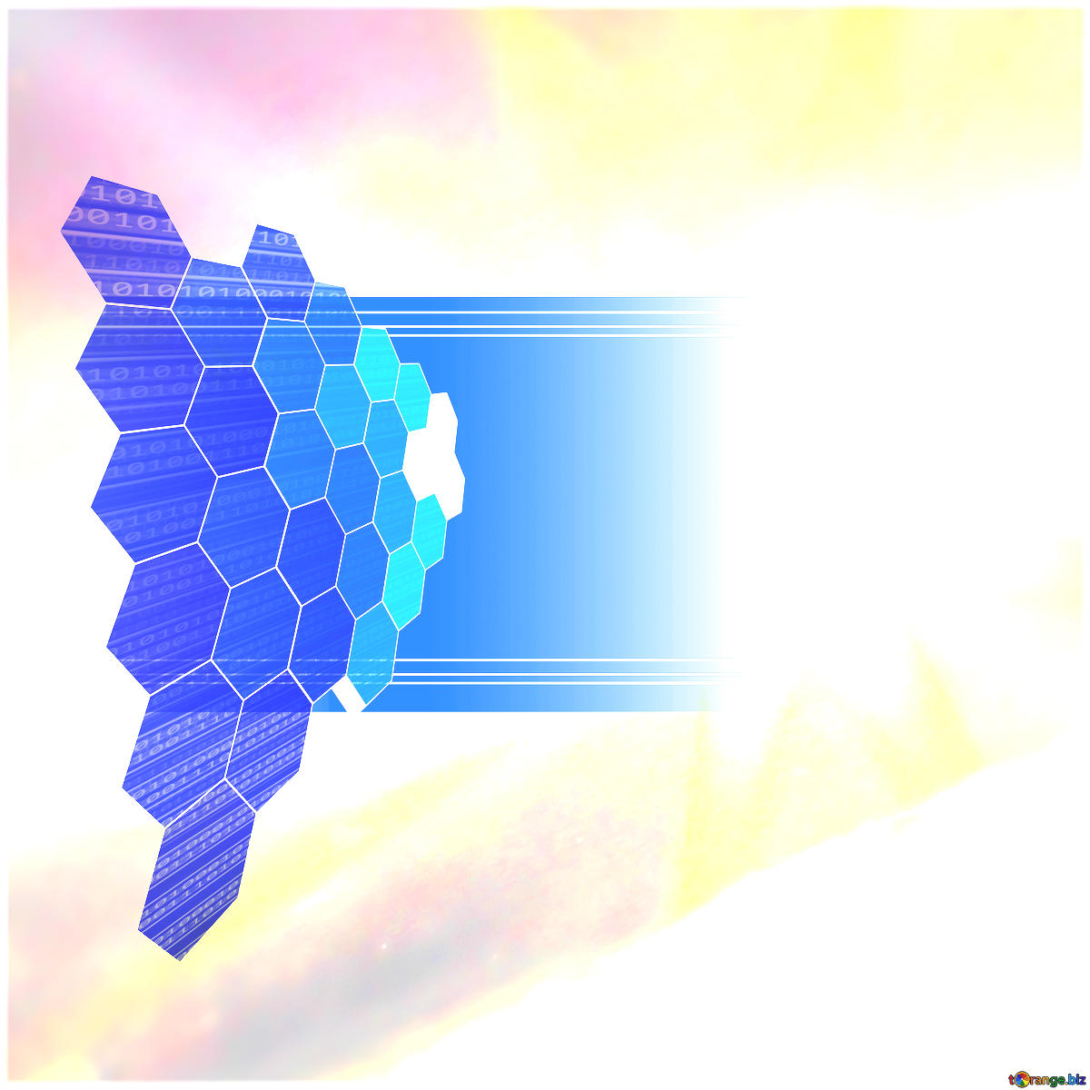
Utilising Humanoid Robotic For Sign Language (Sl) Tutor
Parastoo Porhonar (st20136791)
Cardiff Metropolitan University, BSC Computer Science Honors
Supervisor Name: Dr Esyin Chew
Notes:
https://www.analyticsvidhya.com/blog/2021/06/sign-language-recognition-for-computer-vision-enthusiasts/

Slide 2
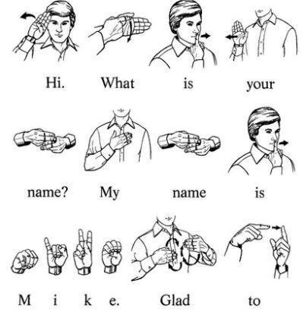
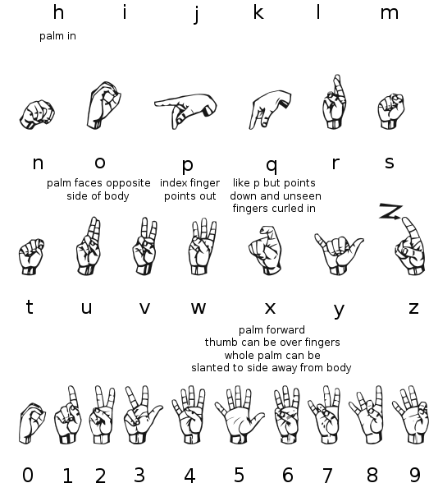
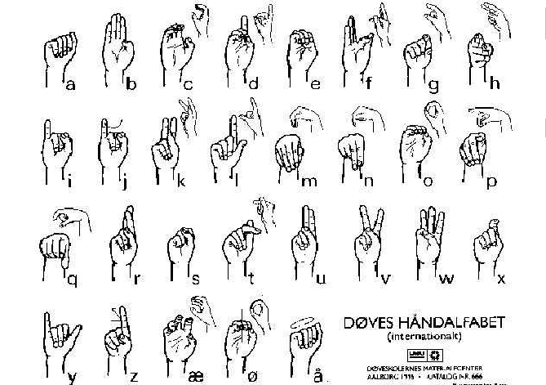
WHAT IS SIGN LANGUAGE?
Fingerspelling
World-level sign vocabulary
Non-manual features

Slide 3
National Institute on Deafness and Other Communication Disorders
There are 300 distinct sign languages across the world
98% of deaf people do not receive education in sign language
72% of families do not sign with their deaf children
70% of deaf people don't work or are underemployed
9 out of 10 children who are born deaf are born to parents who hear, which has also pushed the call for early education of SL.
1 in 4 deaf people has left a job due to discrimination
1 in 4 deaf women will be sexually assaulted in their lifetimes, compared to 1 in 10 hearing women

Slide 4

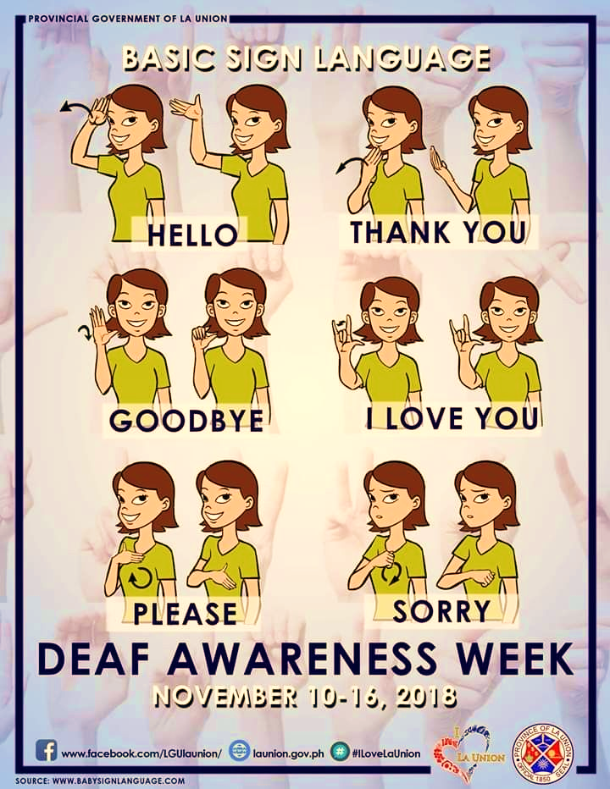
Sign Language
Is a system of communication for people who cannot hear that uses hand and finger movements
https://youtu.be/bFIAHKOSJlE
Notes:
Cambridge dictionary

Slide 5
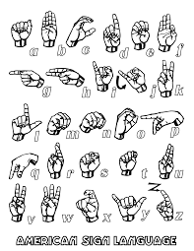
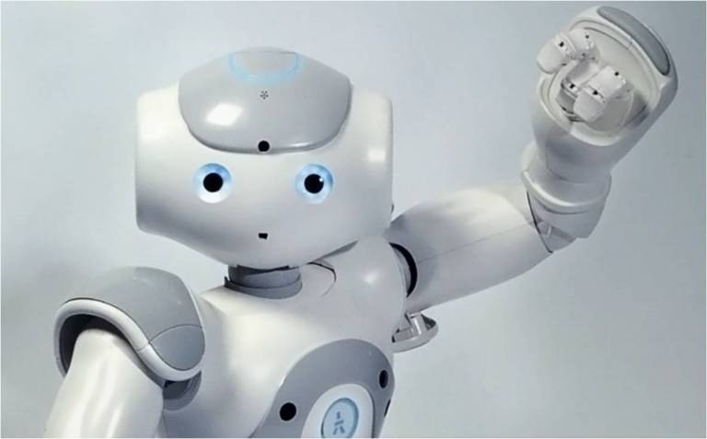
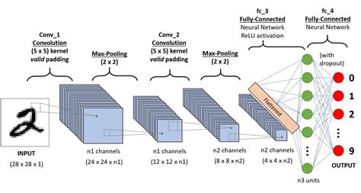

Slide 6
Problem Description:
This paper focuses on creating an interactive educational line between the hearing-impaired , normal people and humanoid robot with the help of computer vision. To do so first a classification model is built to identify the sign alphabet using CNN and then for real time application the hand gesture sign is detected using OpenCV and fed to the model to make the final prediction . And after recognition for further use of human robot visional recognition.

Slide 7
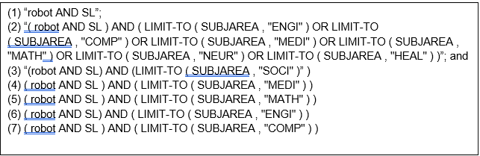
Systematic Literature Review:
From 15th February 2017 to 15th March 2021, a combination of a small set of keywords to find the overall research landscape of robotics in Sign language technology and education, as well as interdisciplinary research (Engineering, Computer Science, Medicine, Mathematics, Neuroscience, Health, and Social Science).
Figure one: keyword Combination for Article Search

Slide 8
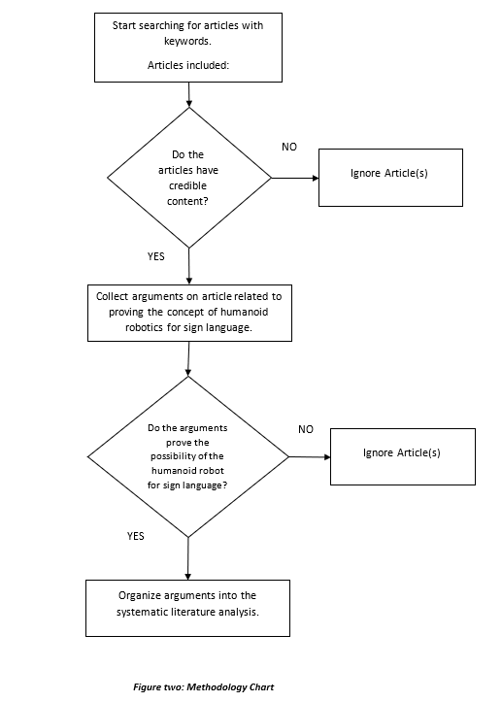

Slide 9
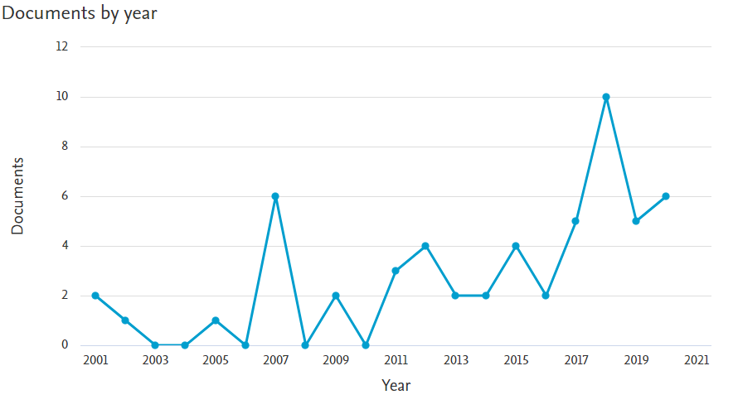
History and International Profile of Publication on SL Robotics

Slide 10
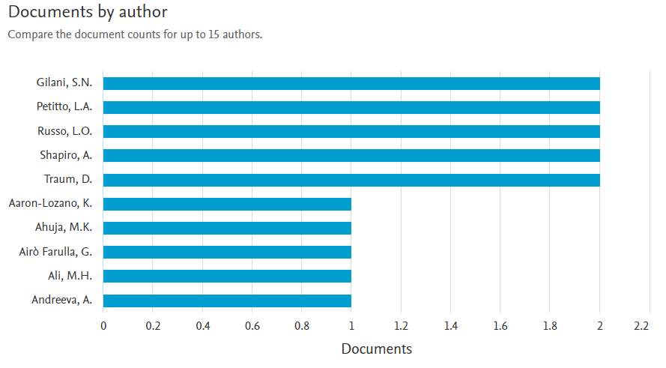
History and International Profile of Publication on SL Robotics

Slide 11
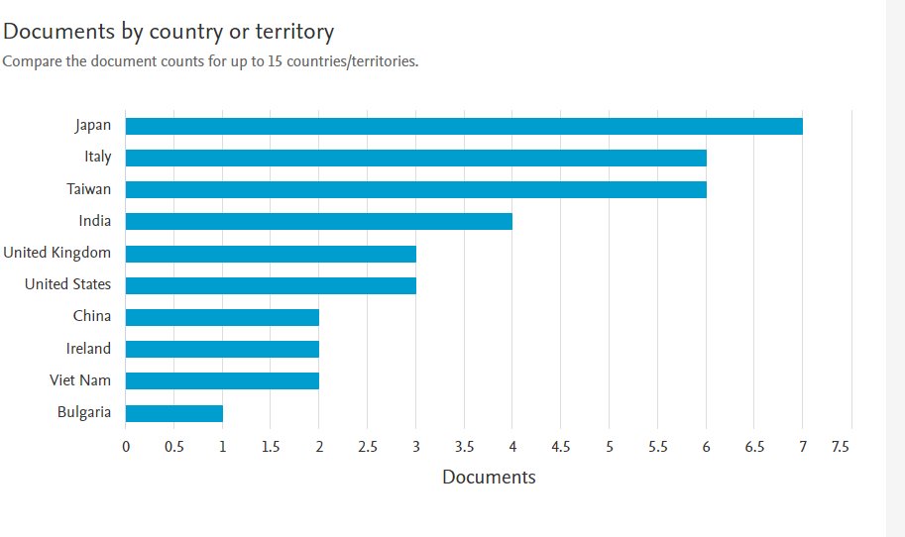
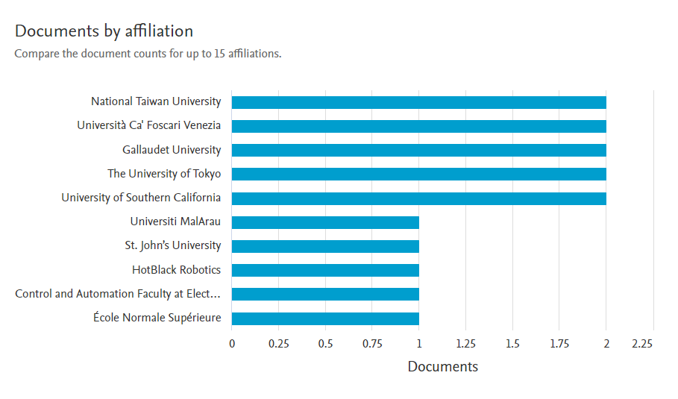
History and International Profile of Publication on SL Robotics

Slide 12
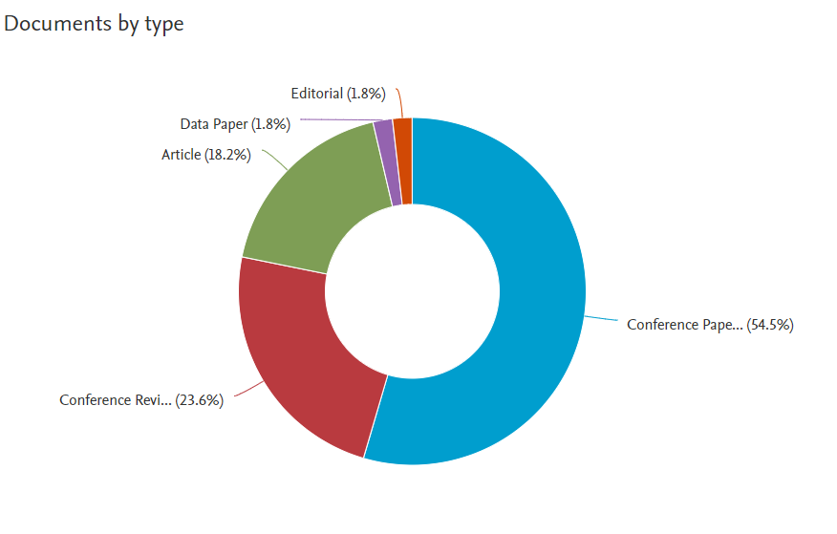
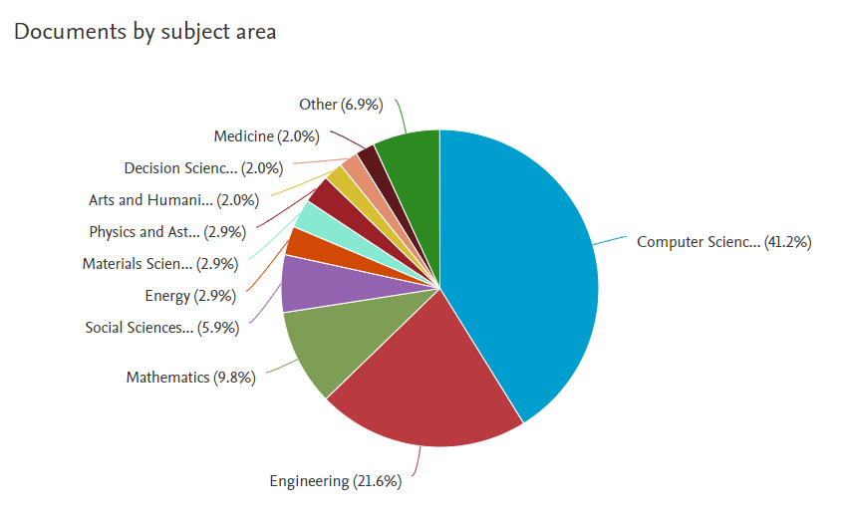
History and International Profile of Publication on SL Robotics

Slide 13
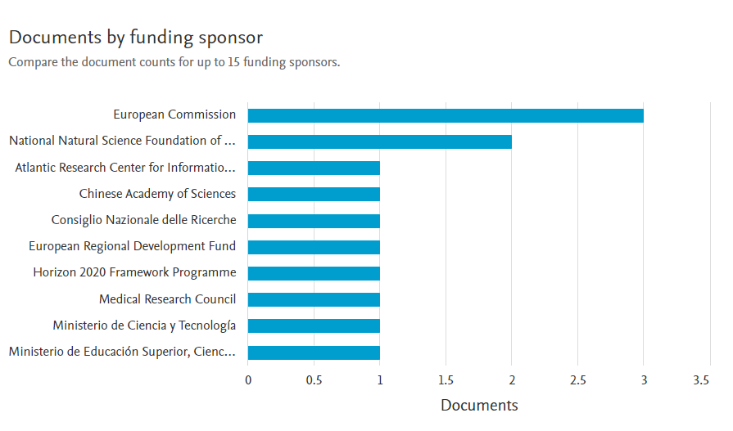
History and International Profile of Publication on SL Robotics

Slide 14
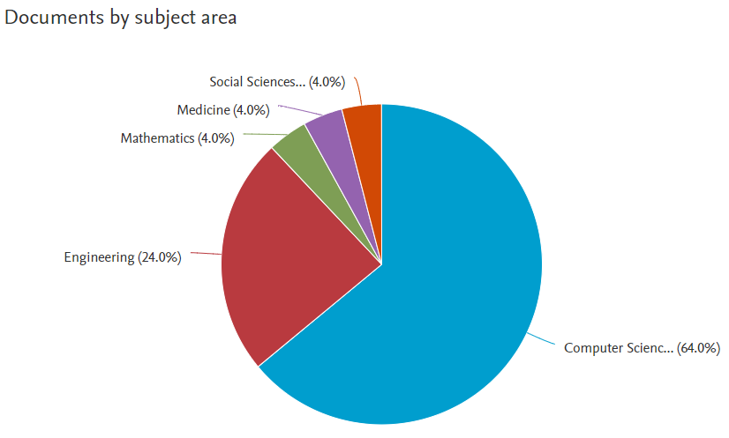
Humanoid robot Application in sign language education

Slide 15
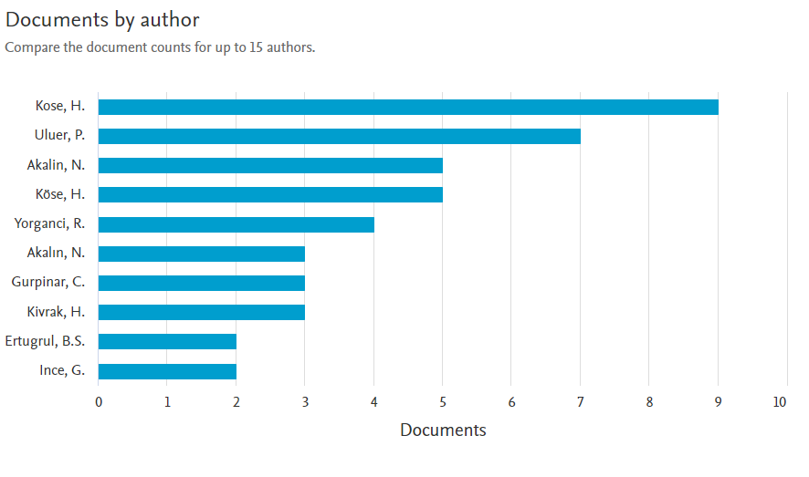
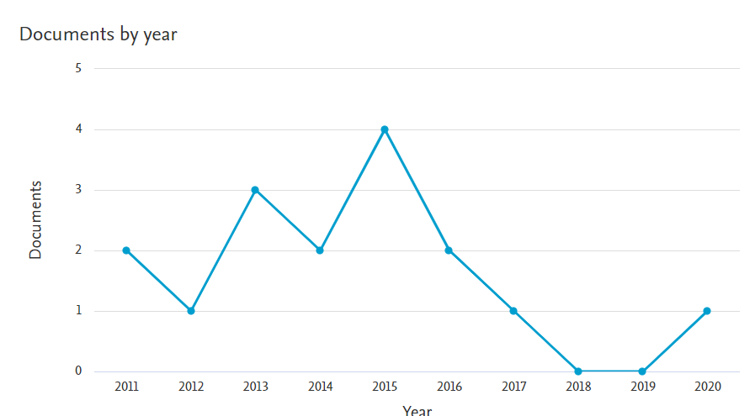
Humanoid robot Application in sign language education

Slide 16
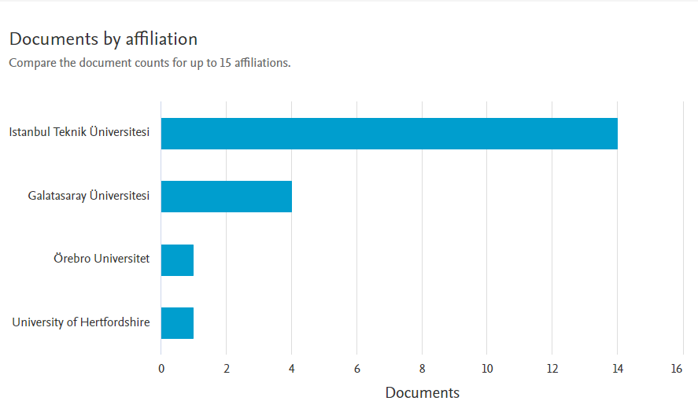
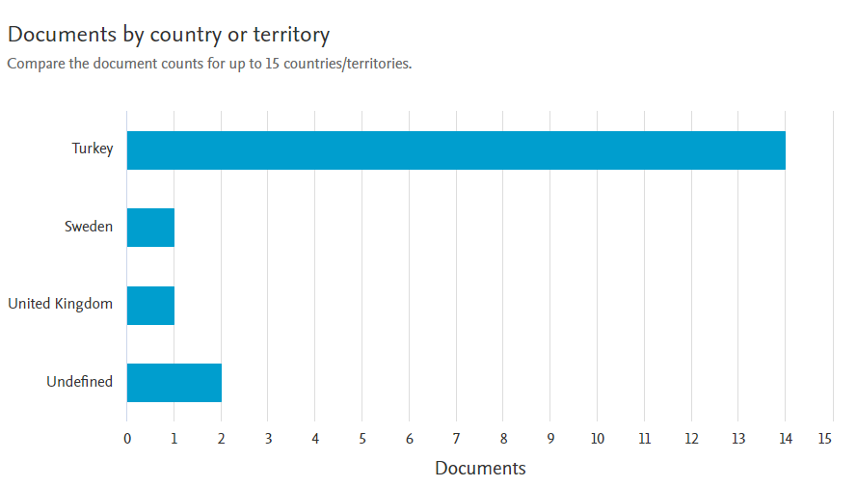
Humanoid robot Application in sign language education

Slide 17
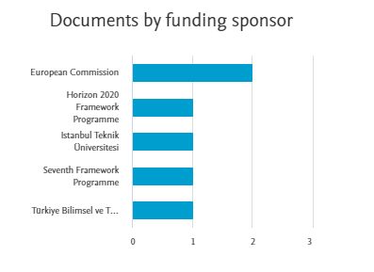
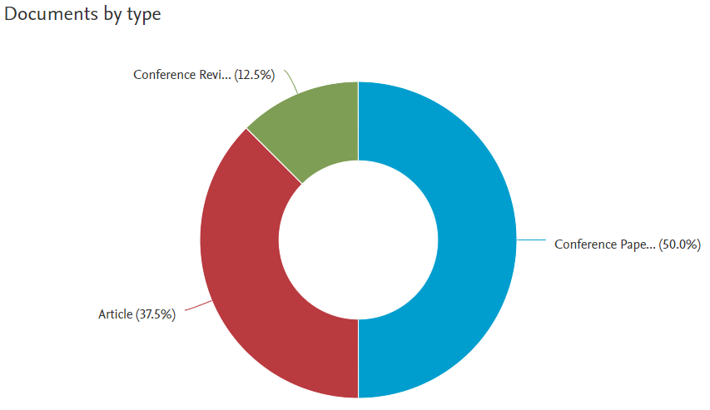
Humanoid robot Application in sign language education

Slide 18
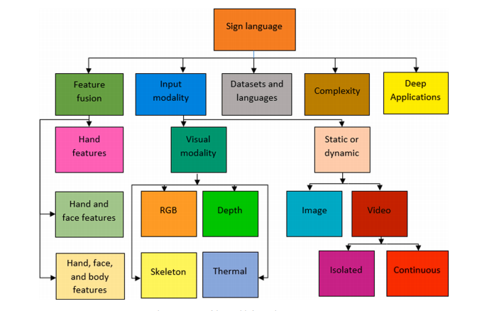
Taxonomy for Robotics in Sign language and Robotics Technologies in Sign language

Slide 19
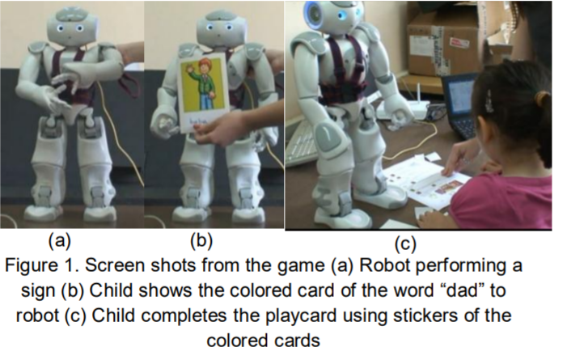
Literature Review
Humanoid robot assisted interactive Turkish sign language tutoring game
Hatice Kose (Bagci)*, Rabia Yorganci and Itauma I. Itauma ( 2011) Turky

Slide 20
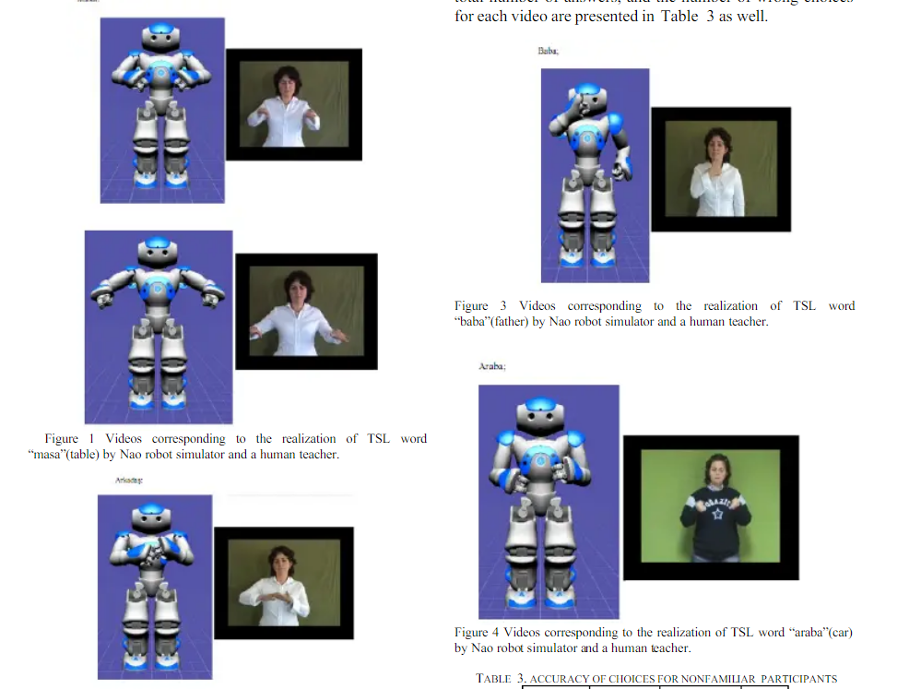
Literature Review
A New Robotic Platform for Sign Language Tutoring Humanoid Robots as Assistive Game Companions for Teaching Sign Language.(2015)
Evaluation of the Robot Sign Language Tutoring Assistant Using Video-Based Studies
Social Robotics Lab, Faculty of Computer and Informatics, Istanbul Technical University, Istanbul, Turkiye
H. Kose- Bagci, R. Yorganci , H. E. Algan

Slide 21
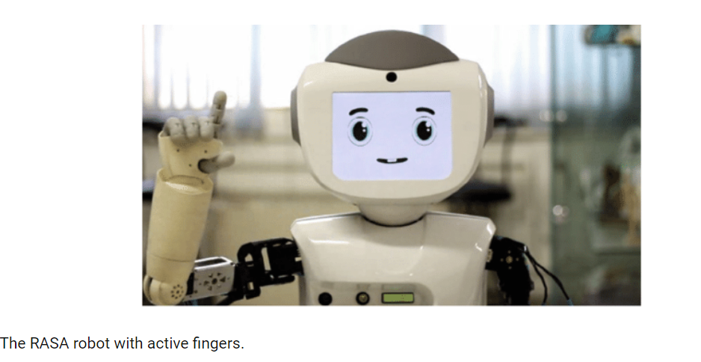
Similar work
Teaching Persian Sign Language to a Social Robot via the Learning from Demonstrations Approach
Evaluation of the Robot Sign Language Tutoring Assistant Using Video-Based Studies
Hosseini, Seyed & Taheri, Alireza & Meghdari, Ali & Alemi, Minoo. (2019). Teaching Persian Sign Language to a Social Robot via the Learning from Demonstrations Approach. 10.1007/978-3-030-35888-4_61.

Slide 22
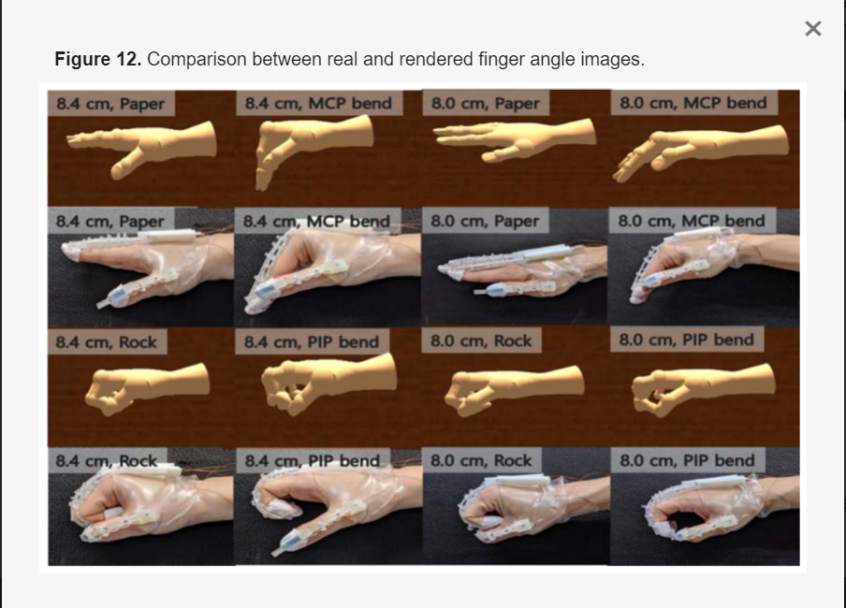
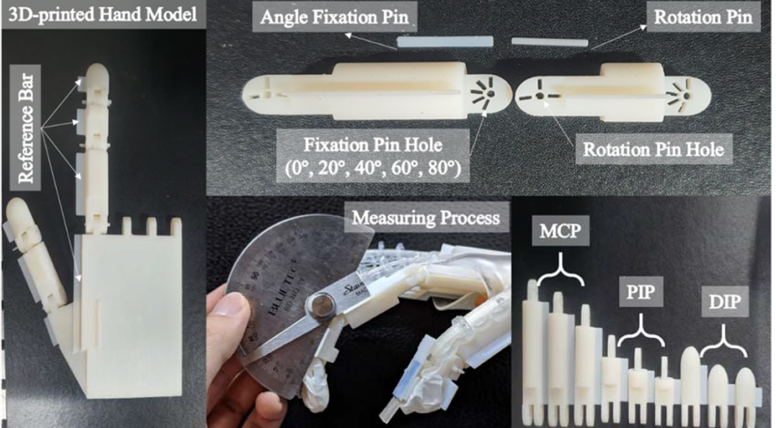
Literature Review
Rendering of Fingers of Different Users in Real Time
At Corea Kakkoth and Charge’s technology of using real time gesture in configuring hand signals for robotics.

Slide 23
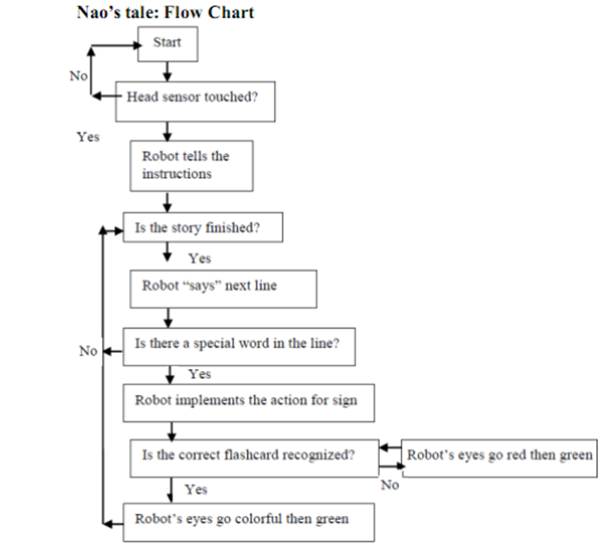
System Features of the NAO V6 Humanoid Robot

Slide 24
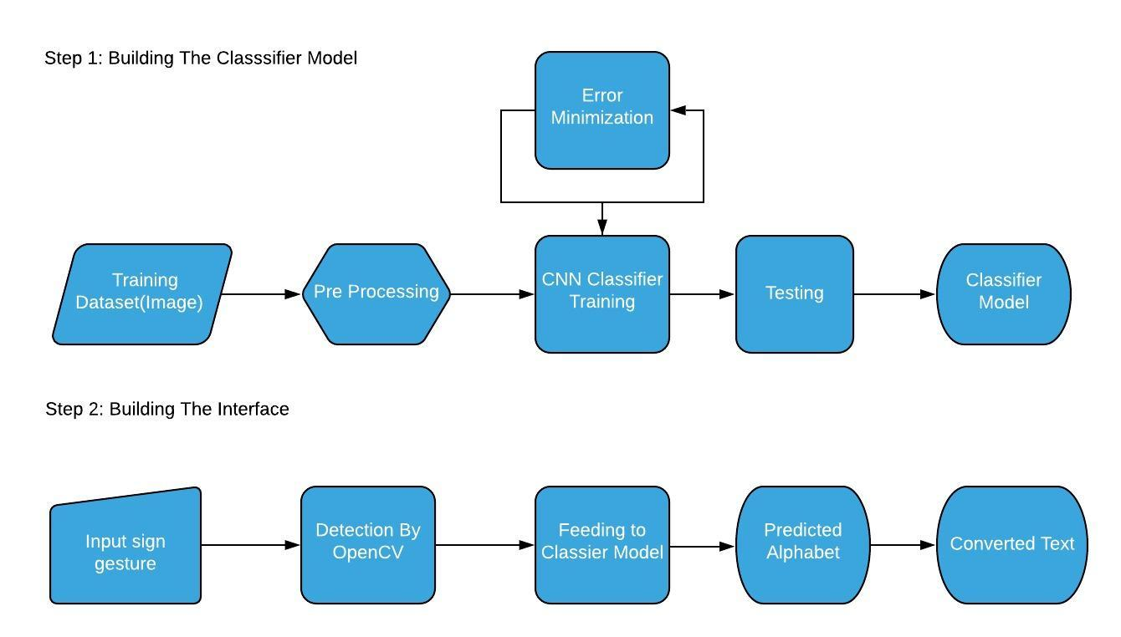
Work Plan:

Slide 25
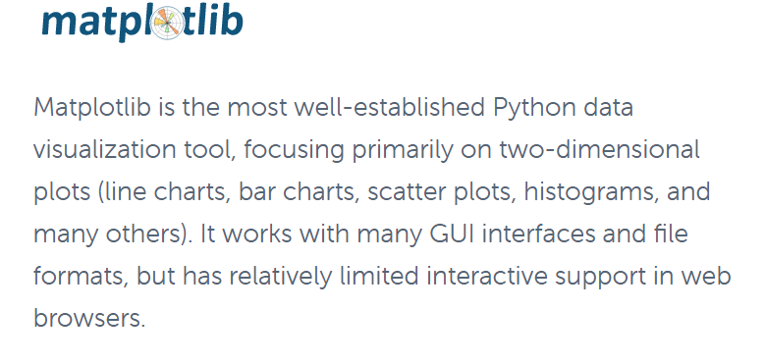
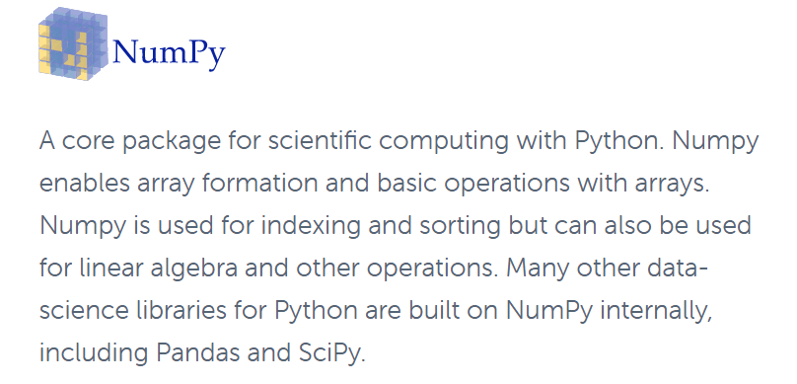
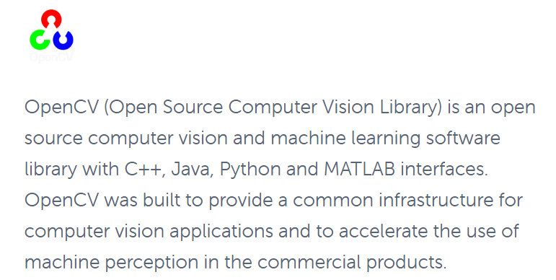
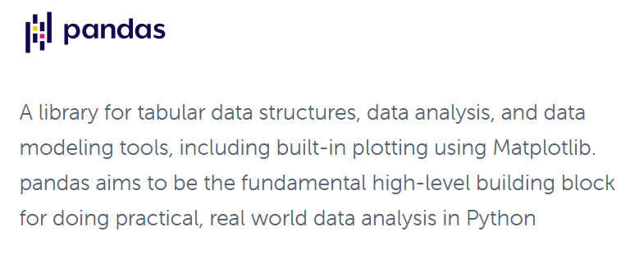
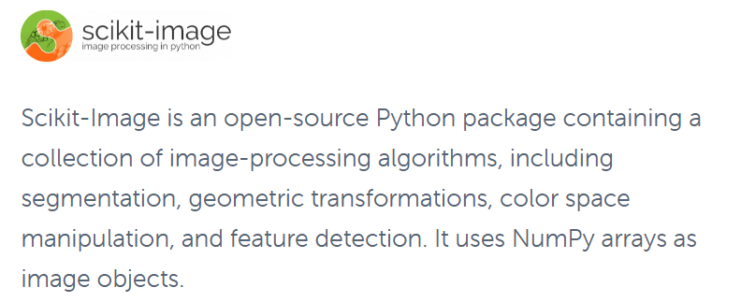
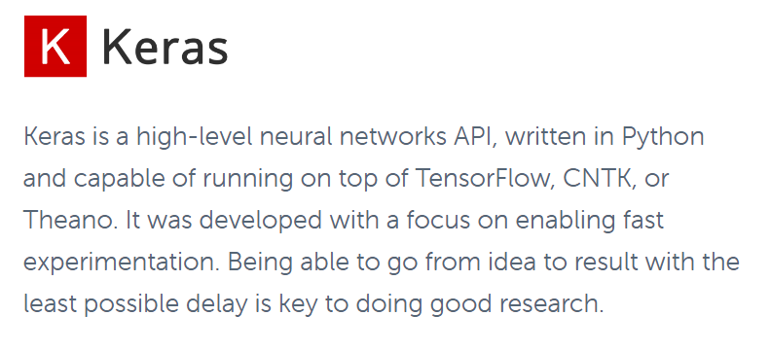

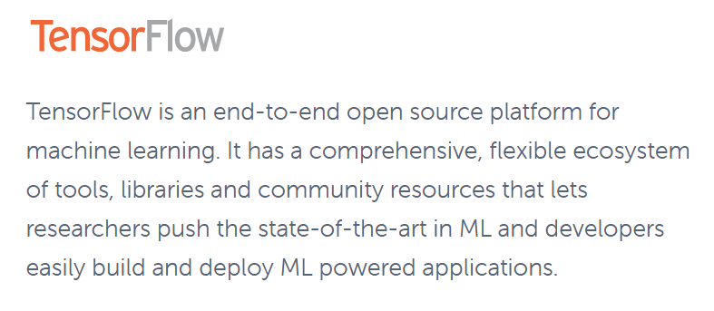


Summery off
Notes:
^start(animations/Stand/Gestures/Hey_3)
Ok
^wait(animations/Stand/Gestures/Hey_3)
^start(animations/Stand/Gestures/Me_2)
I am playing sentiment analysis
^wait(animations/Stand/Gestures/Me_2)

Slide 26
Module Description:
The modules for the project are:
Preprocessing
Training the CNN model
Making the Interface

Slide 27
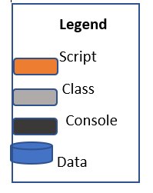
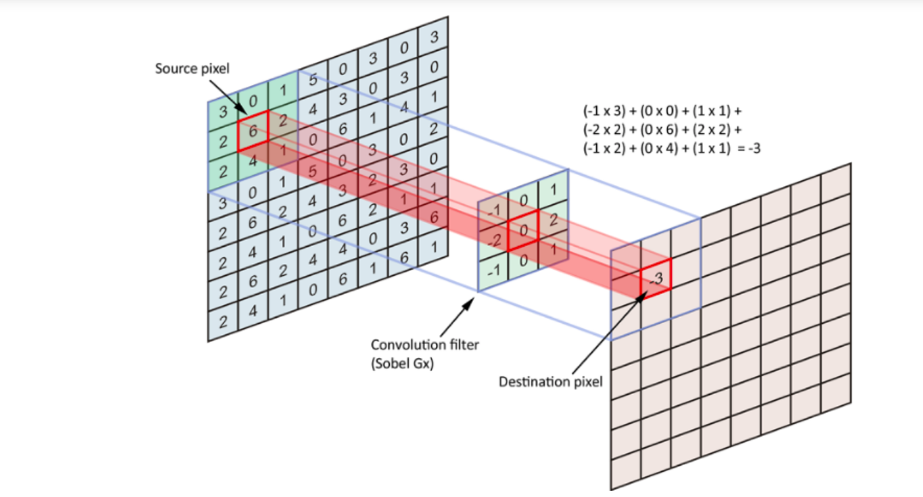
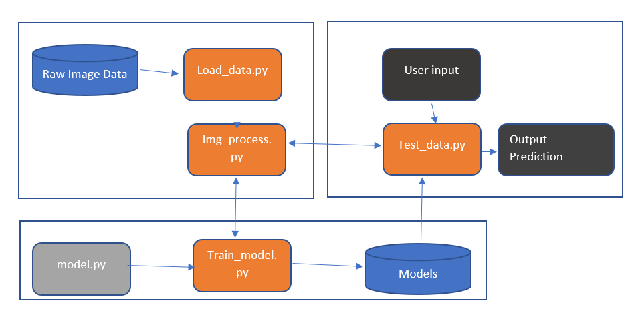
Methodology
Learning/Modelling :
We will use Convolutional Neural Network, or CNN, model to classify the static images in our first dataset.

Slide 28
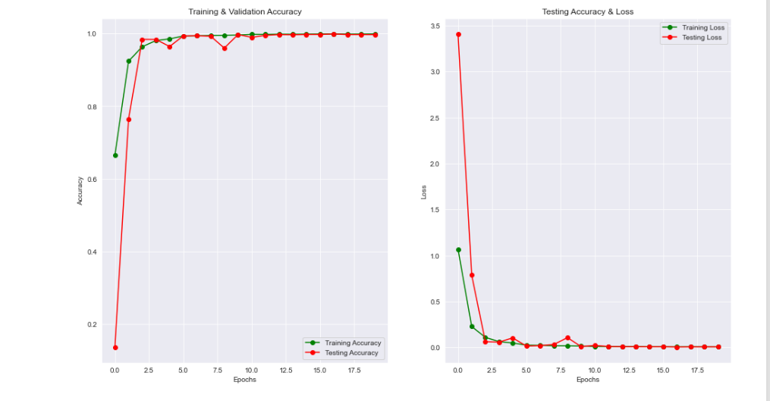

Slide 29
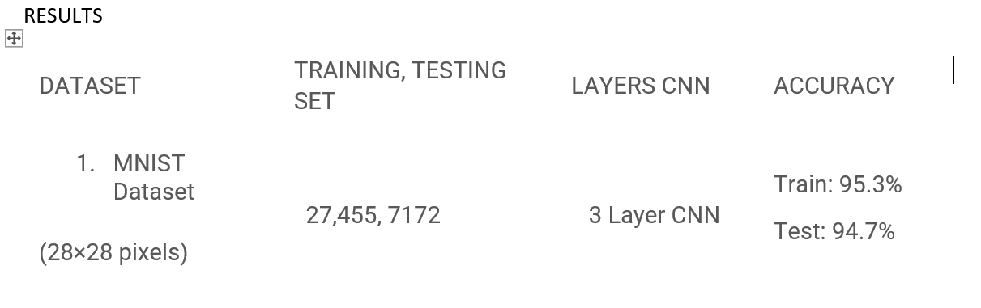

Slide 30
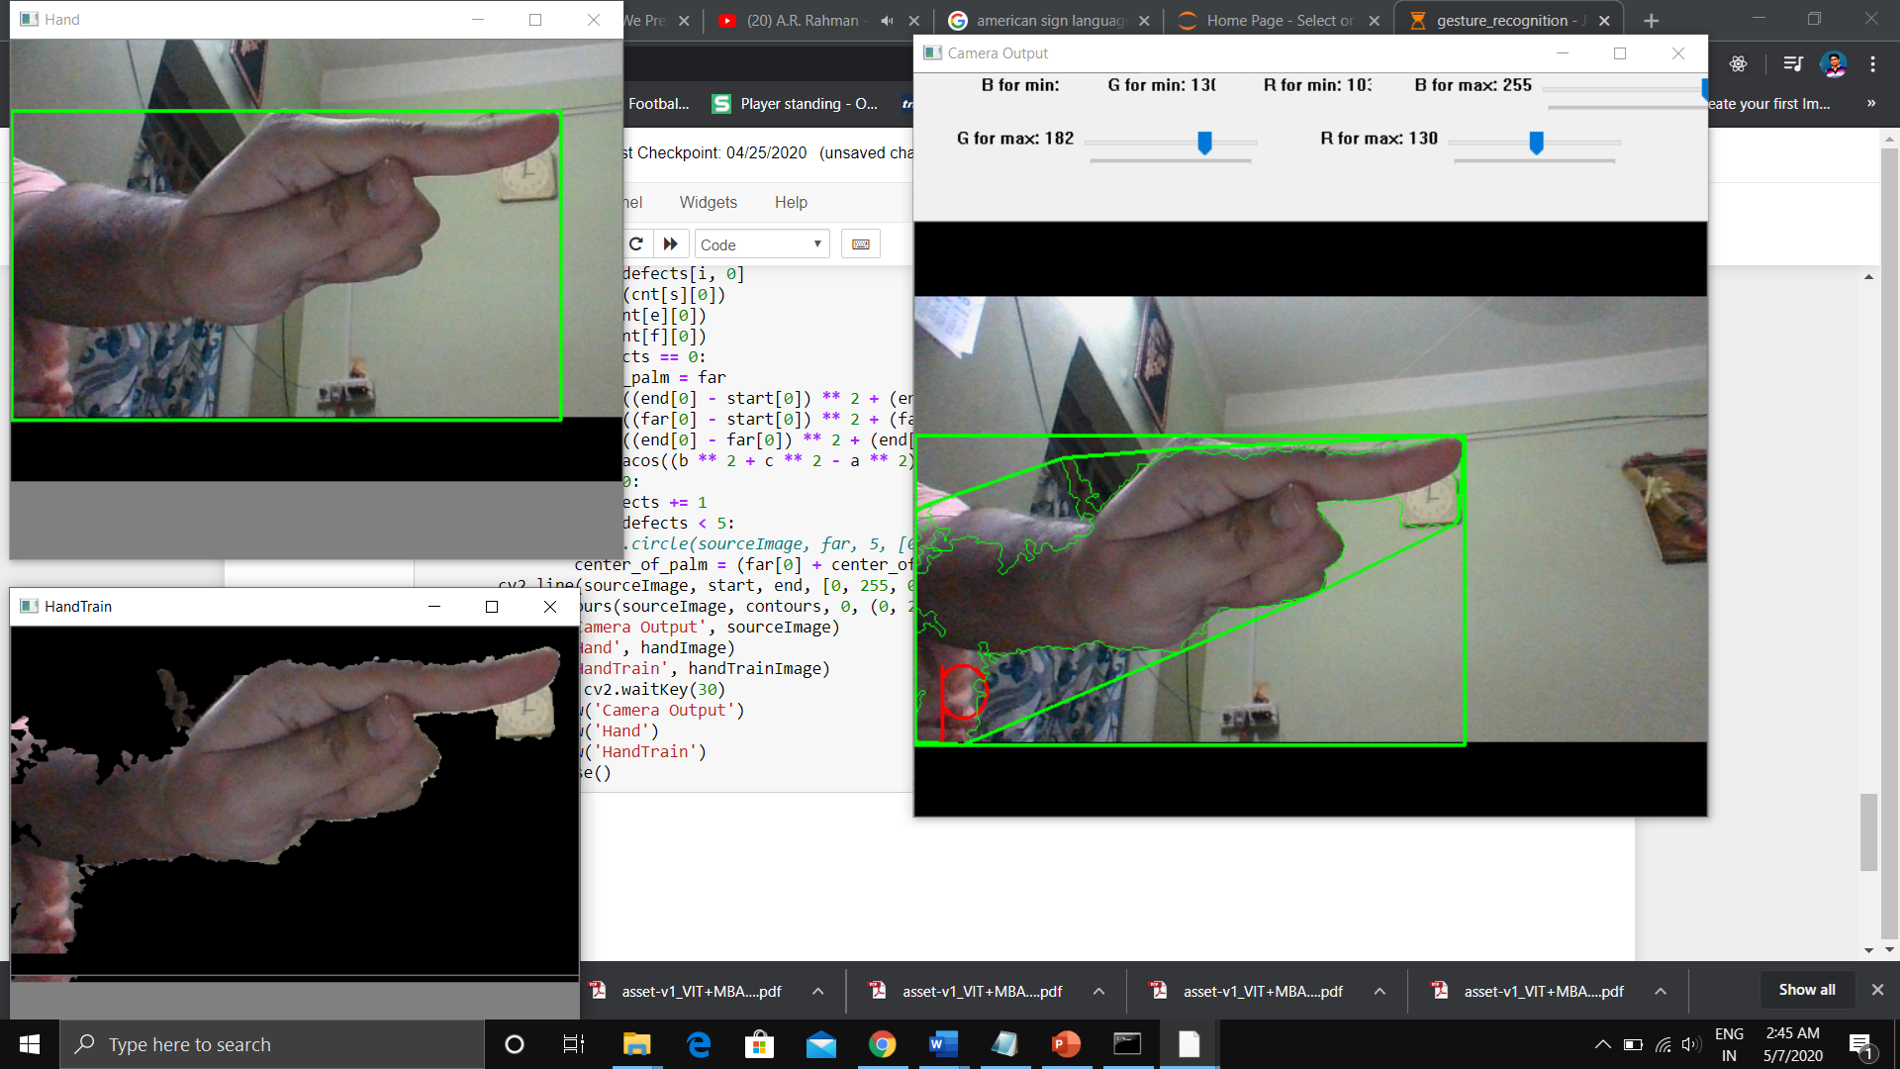
Results:
The trained model is giving 99% accuracy. And the interface is stable.

Slide 31
Preprocessing:
The first task is to preprocess the images. In order to do so first a background of dark is pasted around all the images and the images are converted to ‘RGB’ format to make the image channels similar. Next all the images are transformed to similar dimension 400x400. At the end images are saved but while saving the images extension of the images are changed to .jpeg from .png.

Slide 32
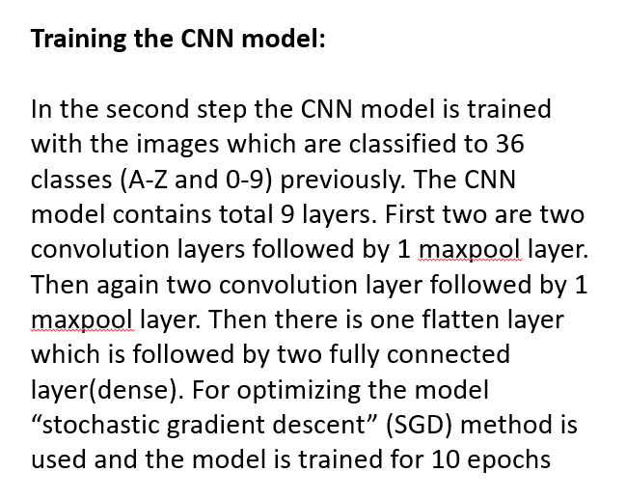

Slide 33
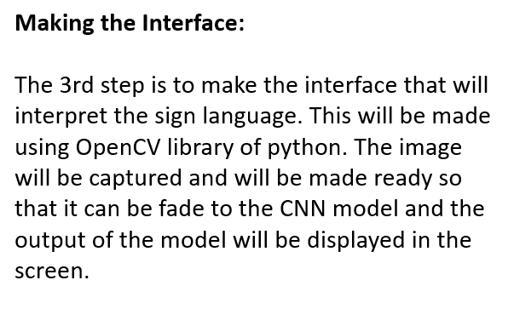

Slide 34
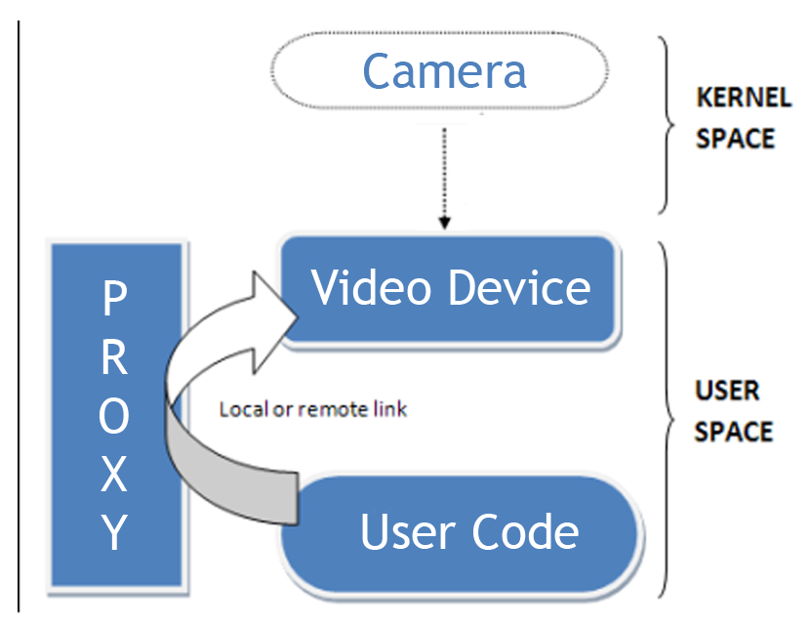
USING PYTHON TO DEVELOP YOUR VISION ALGORITHM
NAOQI Vision Architecture

Slide 35

Developing our Vision Algorithm
A. Image Processing
Retrieve an image in the python world from NAO camera
Process the image
B. Integration in the complete behavior in choregraphe
Box and sub boxes
Tuning the right head position using video monitor
Omnidirectional Walk
Installing a time out
Various way to finish the behavior
C. Disgression

Slide 36
Conclusion:
This system can be used in the medical, educational and many other fields. We will be very happy if the system comes in use of society and people. In the next versions we will try to make the system more accurate and stable than this version and will try to add more features like recognizing more kind of hand and face gestures like ASL World.

Slide 37

This Photo by Unknown author is licensed under CC BY.

